Slide 1
Computer Networks
By Sadiq Shah
Lecture 12
(Chapter 18)
FATA University

Slide 2
Network Layer-II

Slide 3
IPV4 ADDRESSES
An IPv4 address is a 32-bit address that uniquely and universally defines the connection of a host or a router to the Internet.
The IP address is the address of the connection, not the host or the router, because if the device is moved to another network, the IP address may be changed.
IPv4 addresses are unique in the sense that each address defines one, and only one, connection to the Internet.
If a device has two connections to the Internet, via two networks, it has two IPv4 addresses

Slide 4
Address Space
An address space is the total number of addresses used by the protocol.
If a protocol uses b bits to define an address, the address space is 2^{b} because each bit can have two different values (0 or 1).
IPv4 uses 32-bit addresses, which means that the address space is 2³² or 4,294,967,296 (more than four billion).
Notation
There are three common notations to show an IPv4 address: binary notation (base 2), dotted-decimal notation (base 256), and hexadecimal notation (base 16).
In binary notation, an IPv4 address is displayed as 32 bits.
To make the address more readable, one or more spaces are usually inserted between each octet (8 bits). Each octet is often referred to as a byte.

Slide 6
Hierarchy in Addressing
In a postal network, the postal address (mailing address) includes the country, state, city, street, house number, and the recipient
A 32-bit IPv4 address is also hierarchical, but divided only into two parts. The first part of the address, called the prefix, defines the network; the second part of the address, called the suffix, defines the node.
The prefix length is n bits and the suffix length is (32 − n) bits.

Slide 7
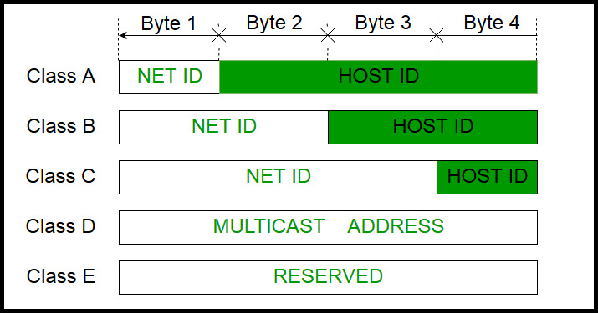
Classful Addressing
The whole address space was divided into five classes (class A, B, C, D, and E).
Although classful addressing belongs to the past, it helps us to understand classless addressing, discussed later
IPv4 address is divided into two parts:
Network ID
Host ID

Slide 9
Class A
IP addresses belonging to class A ranges from 1.x.x.x – 126.x.x.x
IP address belonging to class A are assigned to the networks that contain a large number of hosts.
The network ID is 8 bits long.
The host ID is 24 bits long.

Slide 10
Class B
IP address belonging to class B are assigned to the networks that ranges from medium-sized to large-sized networks.
The network ID is 16 bits long.
The host ID is 16 bits long.
IP addresses belonging to class B ranges from 128.0.x.x – 191.255.x.x.

Slide 11
Class C
IP address belonging to class C are assigned to small-sized networks.
The network ID is 24 bits long.
The host ID is 8 bits long.
IP addresses belonging to class C ranges from 192.0.0.x – 223.255.255.x.

Slide 12
Class D: Multicasting
IP address belonging to class D are reserved for multi-casting.
The higher order bits of the first octet of IP addresses belonging to class D are always set to 1110.
IP addresses belonging to class D ranges from 224.0.0.0 – 239.255.255.255.

Slide 13
Class E
IP addresses belonging to class E are reserved for experimental and research purposes.
IP addresses of class E ranges from 240.0.0.0 – 255.255.255.254

Slide 14
Exercise
Find the class of the following classful IP addresses????
a. 130.34.54.12 -------- B
b. 200.34.2.1 -----------C
c. 245.34.2.8 -------------E
Find the class of the following classful IP addresses:
a. 01110111 11110011 10000111 11011101
A

